Slide 1
Decision Tree
By Dr. Supriya Chakraborty

Slide 2
Outline of the Presentation
Decision Tree Learning: Representing concepts as decision trees.
Recursive induction of decision trees.
Picking the best splitting attribute: entropy and information gain.
Searching for simple trees and computational complexity.
Occam's razor.
Overfitting, noisy data, and pruning.

Slide 3
Definition
A decision tree is a classifier in the form of a tree structure with two types of nodes:
–Decision node: Specifies a choice or test of some attribute, with one branch for each outcome
–Leaf node: Indicates classification of an example

Slide 4
Example – Approve a Loan or Not?

Slide 5
Another Example – Car Mileage

Slide 6
Issues
Given some training examples, what decision tree should be generated?
•One proposal: prefer the smallest tree that is consistent with the data (Bias)
–the tree with the least depth?
–the tree with the fewest nodes?
•Possible method:
–search the space of decision trees for the smallest decision tree that fits the data

Slide 7
Example Data
Training Examples:
New Examples:

Slide 8
Possible Splits

Slide 9
Two Possible Decision Tree

Slide 10
Decision Tree for Play Tennis
Attributes and their values:
–Outlook: Sunny, Overcast, Rain
–Humidity: High, Normal
–Wind: Strong, Weak
–Temperature: Hot, Mild, Cool
•Target concept -Play Tennis: Yes, No

Slide 11
Decision Tree for PlayTennis

Slide 12
Decision Tree for PlayTennis

Slide 13
Decision trees represent disjunctions of conjunctions

Slide 14
Search for a good tree
The space of decision trees is too big for systematic search.
•Stop and
–return the a value for the target feature or
–a distribution over target feature values
•Choose a test (e.g. an input feature) to split on.
–For each value of the test, build a subtree for those examples with this value for the test.

Slide 15
Top-down Induction of Decision Tree
1.A the “best”decision attribute for next node
2.Assign A as decision attribute for node
3.For each value of A create new descendant
4.Sort training examples to leaf node according to the attribute value of the branch
5.If all training examples are perfectly classified (same value of target attribute) stop, else iterate over newleaf nodes.

Slide 16
Choices
When to stop
–no more input features
–all examples are classified the same
–too few examples to make an informative split
•Which test to split on
–split gives smallest error.
–With multi-valued features
•split on all values or
•split values into half.

Slide 17
Which attribute to start with?
Consider the algorithm Top-Down Induction for decision tree and determine the best attribute to start with?

Slide 18
Principal Criteria
Selection of an attribute to test at each node -choosing the most useful attribute for classifying examples.
•information gain
–measures how well a given attribute separates the training examples according to their target classification
–This measure is used to select among the candidate attributes at each step while growing the tree
–Gain is measure of how much we can reduce uncertainty (Value lies between 0,1)

Slide 19
Entropy
A measure for
–uncertainty
–purity
–information content
•Information theory: optimal length code assigns (-log2p)bits to message having probability p
•Sis a sample of training examples
–p+is the proportion of positive examples in S
–p-is the proportion of negative examples in S
•Entropy of S: average optimal number of bits to encode information about certainty/uncertainty about S
Entropy(S) = p+(-log2p+) + p-(-log2p-)= -p+log2p+-p-log2p-

Slide 20
Entropy
The entropy is 0 if the outcome is ``certain”.
The entropy is maximum if we have no knowledge of the system (or any outcome is equally possible).
•S is a sample of training examples
•p+ is the proportion of positive examples
•p-is the proportion of negative examples
•Entropy measures the impurity of S
Entropy(S) = -p₊log₂p₊-p₋log₂p₋

Slide 21
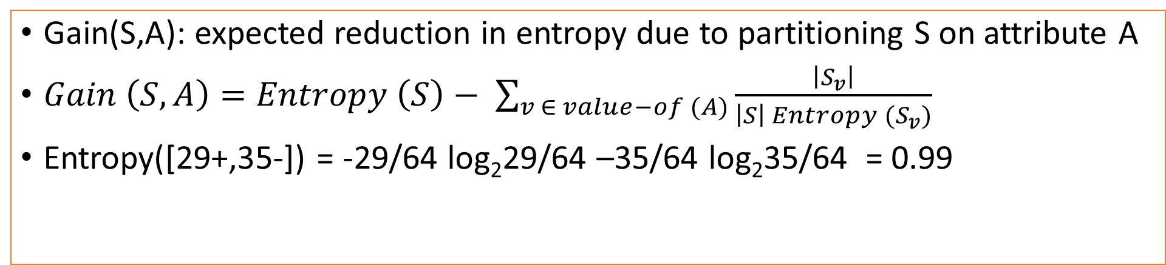
Information Gain
Gain(S,A): expected reduction in entropy due to partitioning S on attribute A
$Gain \left(S,A\right)=Entropy \left(S\right)− \sum_{v ∈ value−of (A)}{\frac{\left|S_{v}\right|}{\left|S\right| Entropy (S_{v})}}$
Entropy([29+,35-]) = -29/64 log₂29/64 –35/64 log₂35/64 = 0.99

Slide 22
Training Example

Slide 23
Selecting the Next Attribute
S=[9+,5-] S=[9+,5-]
E=0.940 E=0.940

Slide 24
Selecting Next Attribute

Slide 25
Selecting the next attribute
The information gain values for the 4 attributes are:
•Gain(S,Outlook) =0.247
•Gain(S,Humidity) =0.151
•Gain(S,Wind) =0.048
•Gain(S,Temperature) =0.029

Slide 29
Splitting based on Continuous Attribute

Slide 30
Continuous Attribute – Binary Split

Slide 31
Practical Issues of Classification
Underfitting and Overfitting
Missing Values
Costs of Classification

Slide 32
Hypothesis Space Search in Decision Tree
•Conduct a search of the space of decision trees which can represent all possible discrete functions.
•Goal: to find the best decision tree
•Finding a minimal decision tree consistent with a set of data is NP-hard.
•Perform a greedy heuristic search: hill climbing without backtracking
•Statistics-based decisions using all data

Slide 33
Bias and Occam’s Razor
Prefer short hypotheses.
Argument in favor:
–Fewer short hypothesesthanlong hypotheses
–A short hypothesisthatfits the data is unlikelytobe a coincidence
–A long hypothesisthatfits the data mightbe a coincidence

Slide 34
Overfitting
Learning a tree that classifies the training data perfectly may not lead to the tree with the best generalization performance.
–There may be noise in the training data
–May be based on insufficient data
•A hypothesis h is said to overfit the training dataif there is another hypothesis, h’, such thathhas smaller error than h’on the training data but hhas larger error on the test data than h’

Slide 35
Overfitting
A hypothesis h is said to overfit the training data if there is another hypothesis, h’, such that h has smaller error than h’ on the training data but h has larger error on the test data than h’.

Slide 36
Underfitting
Underfitting: When the model is too simple, the training and testing error are large.
Overfitting also occur due to noise in the data.

Slide 37
Avoid Overfitting
•How can we avoid overfitting a decision tree?
–Prepruning: Stop growingwhendata split not statisticallysignificant
–Postpruning: Grow full tree then remove nodes
•Methods for evaluating subtrees to prune:
–Minimum descriptionlength(MDL):
Minimize: size(tree) + size(misclassifications(tree))
–Cross-validation

Slide 38
Bias and Variance
Two important measures in statistics.
Notes:
Understanding bias and variance, which have roots in statistics, is essential for data scientists involved in machine learning. Bias and variance are used in supervised machine learning, in which an algorithm learns from training data or a sample data set of known quantities. The correct balance of bias and variance is vital to building machine-learning algorithms that create accurate results from their models.

Slide 39
What Is Bias?
Also called “error due to squared bias,” bias is the amount that a model’s prediction differs from the target value, compared to the training data. Bias error results from simplifying the assumptions used in a model so the target functions are easier to approximate.
Also the data set does not reflect the real-world, the model has bias.
Notes:
Also called “error due to squared bias,” bias is the amount that a model’s prediction differs from the target value, compared to the training data. Bias error results from simplifying the assumptions used in a model so the target functions are easier to approximate. Bias can be introduced by model selection. Data scientists conduct resampling to repeat the model building process and derive the average of prediction values. Resampling data is the process of extracting new samples from a data set in order to get more accurate results. There are a variety of ways to resample data including:
K fold resampling, in which a given data set is split into a K number of sections, or folds, where each fold is used as a testing set.
Bootstrapping, which involves iteratively resampling a dataset with replacement.
Resampling can affect bias. If the average prediction values are significantly different from the true value based on the sample data, the model has a high level of bias.
Every algorithm starts with some level of bias, because bias results from assumptions in the model that make the target function easier to learn. A high level of bias can lead to underfitting, which occurs when the algorithm is unable to capture relevant relations between features and target outputs. A high bias model typically includes more assumptions about the target function or end result. A low bias model incorporates fewer assumptions about the target function.
A linear algorithm often has high bias, which makes them learn fast. In linear regression analysis, bias refers to the error that is introduced by approximating a real-life problem, which may be complicated, by a much simpler model. Though the linear algorithm can introduce bias, it also makes their output easier to understand. The simpler the algorithm, the more bias it has likely introduced. In contrast, nonlinear algorithms often have low bias.

Slide 40
What is variance
Variance indicates how much the estimate of the target function will alter if different training data were used. In other words, variance describes how much a random variable differs from its expected value. Variance is based on a single training set. Variance measures the inconsistency of different predictions using different training sets — it’s not a measure of overall accuracy.
Notes:
Variance indicates how much the estimate of the target function will alter if different training data were used. In other words, variance describes how much a random variable differs from its expected value. Variance is based on a single training set. Variance measures the inconsistency of different predictions using different training sets — it’s not a measure of overall accuracy.

Slide 41
Bias, Variance Tradeoff
Increasing bias decreases variance, and increasing variance decreases bias.
A model with high variance may represent the data set accurately but could lead to overfitting to noisy or otherwise unrepresentative training data. In comparison, a model with high bias may underfit the training data due to a simpler model that overlooks regularities in the data.
What we want? Low Bias and Low Variance
Notes:
Data scientists building machine learning algorithms are forced to make decisions about the level of bias and variance in their models. Ultimately, the trade-off is well known: increasing bias decreases variance, and increasing variance decreases bias. Data scientists have to find the correct balance.
When building a supervised machine-learning algorithm, the goal is to achieve low bias and variance for the most accurate predictions. Data scientists must do this while keeping underfitting and overfitting in mind. A model that exhibits small variance and high bias will underfit the target, while a model with high variance and little bias will overfit the target.
A model with high variance may represent the data set accurately but could lead to overfitting to noisy or otherwise unrepresentative training data. In comparison, a model with high bias may underfit the training data due to a simpler model that overlooks regularities in the data.
The trade-off challenge depends on the type of model under consideration. A linear machine-learning algorithm will exhibit high bias but low variance. On the other hand, a non-linear algorithm will exhibit low bias but high variance. Using a linear model with a data set that is non-linear will introduce bias into the model. The model will underfit the target functions compared to the training data set. The reverse is true as well — if you use a non-linear model on a linear dataset, the non-linear model will overfit the target function.
To deal with these trade-off challenges, a data scientist must build a learning algorithm flexible enough to correctly fit the data. However, if the algorithm has too much flexibility built in, it may be too linear and provide results with a high variance from each training data set.
In characterizing the bias-variance trade-off, a data scientist will use standard machine learning metrics, such as training error and test error, to determine the accuracy of the model. The Mean Square Error (MSE) can be used in a linear regression model with the training set to train the model with a large portion of the available data and act as a test set to analyze the accuracy of the model with a smaller sample of the data. A small portion of data can be reserved for a final test to assess the errors in the model after the model is selected.
There is always tension between bias and variance. In fact, it’s difficult to create a model that has both low bias and variance. The goal is a model that reflects the linearity of the training data but will also be sensitive to unseen data used for predictions or estimates. Data scientists must understand the difference between bias and variance so they can make the necessary compromises to build a model with acceptably accurate results.

Slide 42
Triple Trade-off
There is a trade-off between three factors:
–Complexity of H, c (H),
–Training set size, N,
–Generalization error, Eon new data
As N increases, E decreases
•As c (H) increases, first E decreases and then E increases
•As c (H)increases, the training error decreases for some time and then stays constant (frequently at 0)
Overfitting

Slide 43
Notes on Overfitting
overfitting happens when a model is capturing idiosyncrasies of the data rather than generalities.
–Often caused by too many parameters relative to the amount of training data.
–E.g. an order-Npolynomial can intersect any N+1data points

Slide 44
Avoid Overfitting
Pruning * Pre-pruning * Post-pruning Ensemble * Random Forest

Slide 45
What is Pruning?
By default, the decision tree model is allowed to grow to its full depth. Pruning refers to a technique to remove the parts of the decision tree to prevent growing to its full depth. By tuning the hyperparameters of the decision tree model one can prune the trees and prevent them from overfitting.
There are two types of pruning Pre-pruning and Post-pruning. Now let's discuss the in-depth understanding and hands-on implementation of each of these pruning techniques.

Slide 46
Pre-pruning?
The pre-pruning technique refers to the early stopping of the growth of the
decision tree. The pre-pruning technique involves tuning the hyperparameters of
the decision tree model prior to the training pipeline.
The hyperparameters of the decision tree including
max_depth, min_samples_leaf, min_samples_split can be tuned to early stop
the growth of the tree and prevent the model from overfitting.

Slide 47
Post-Pruning
The Post-pruning technique allows the decision tree model to grow to
its full depth, then removes the tree branches to prevent the model
from overfitting. Cost complexity pruning (ccp) is one type of
post-pruning technique. In case of cost complexity pruning,
the ccp_alpha can be tuned to get the best fit model.
Scikit-learn package comes with the implementation to compute
the ccp_alpha values of the decision tree using function
cost_complexity_pruning_path(). With the increase in
ccp_apha values, more nodes of the tree are pruned.

Slide 48
Ensemble – Random Forest
Random Forest is an ensemble technique for classification and regression by bootstrapping multiple decision trees. Random Forest follows bootstrap sampling and aggregation techniques to prevent overfitting.
Separate class for Random Forest

Slide 49
Question 1:
Decision trees can be used for the following type of datasets:
I. The attributes are categorical
II. The attributes are numeric valued and continuous
III. The attributes are discrete valued numbers
A. In case I only
B. In case II only
C. In cases II and III only
D. In cases I, II and III
Answer : D

Slide 50
Question 2:
In a binary classification problem, out of 64 data points 29 belong to class I and 35 belong to
class II. What is the entropy of the data set?
A. 0.97
B. 0
C. 1
D. 0.99
Answer : D

Slide 51
Question 3:
Identify whether the following statement is true or false?
“Overfitting is more likely when the set of training data is small”
A. True
B. False
Answer : A

Slide 52
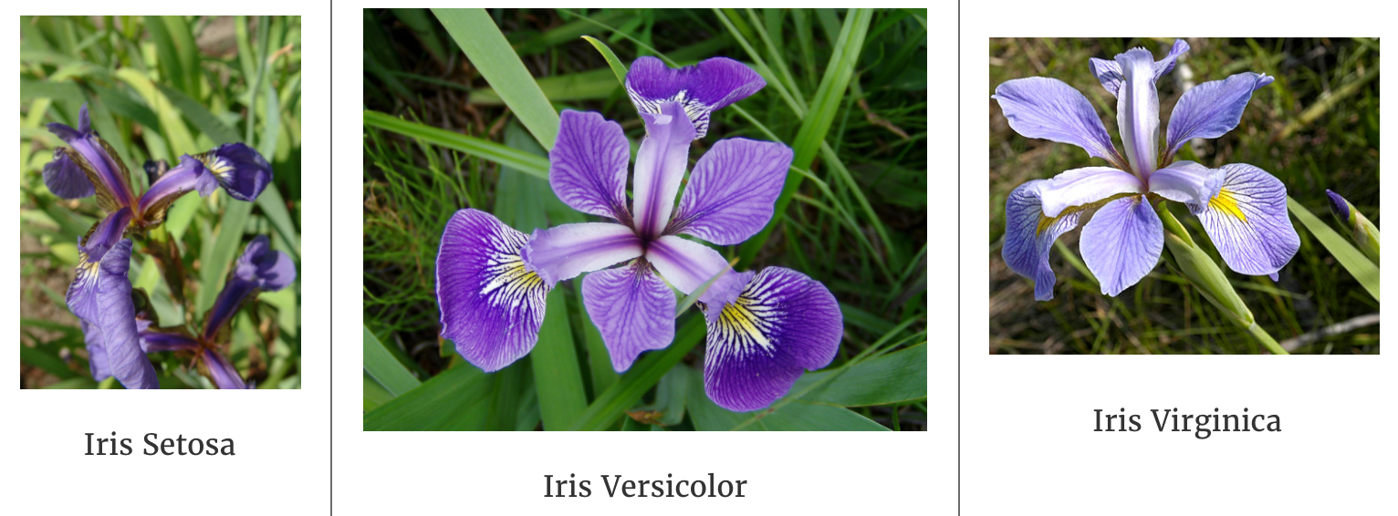
Implementation using Python
Detection of the Iris Flower

Slide 53
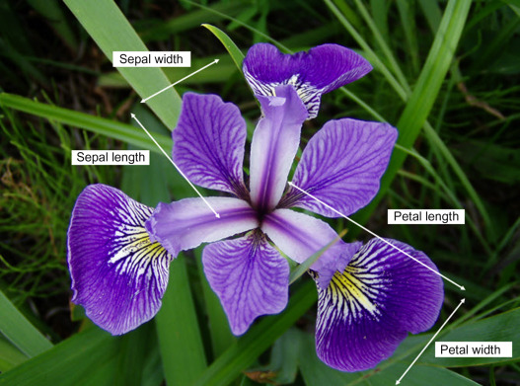
Understanding Data
Attributes :
Sepal Length,
Sepal Width,
Petal Width,
Petal Length,
Species
No. of Records: 150

Slide 54
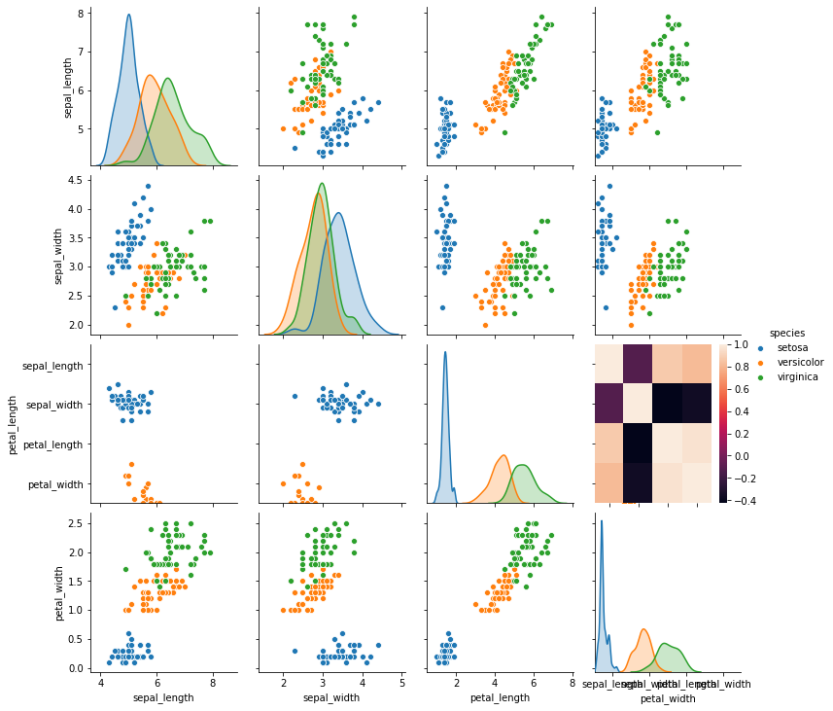
Pairplot | Entropy | GiniIndex
Notes:
Implementation Code
# -*- coding: utf-8 -*-
"""
Decesion Tree- Determination of Differemt types of IRIS Trees
Created on Tue Nov 2 13:46:32 2021
@author: 25623
Source : https://towardsdatascience.com/visualizing-decision-trees-with-python-scikit-learn-graphviz-matplotlib-1c50b4aa68dc
https://www.analyticsvidhya.com/blog/2020/10/all-about-decision-tree-from-scratch-with-python-implementation/
"""
import pandas as pd
import numpy as np
import matplotlib.pyplot as plt
import seaborn as sns
from sklearn.preprocessing import LabelEncoder#for train test splitting
from sklearn.model_selection import train_test_split#for decision tree object
from sklearn.tree import DecisionTreeClassifier#for checking testing results
from sklearn.metrics import classification_report, confusion_matrix#for visualizing tree
from sklearn.tree import plot_tree
#reading the data
df = sns.load_dataset('iris')
df.head()
#getting information of dataset
df.info()
df.shape
df.isnull().any()
# let's plot pair plot to visualise the attributes all at once
sns.pairplot(data=df, hue = 'species')
#in the function of the pairplot () if y_vars and X-vars are not
#passed, then take all the combinatioms
# correlation matrix
sns.heatmap(df.corr())
target = df['species']
df1 = df.copy()
df1 = df1.drop('species', axis =1)
# Defining the attributes
X = df1
target
#label encoding
le = LabelEncoder()
target = le.fit_transform(target)
target
y = target
# Splitting the data - 80:20 ratio
X_train, X_test, y_train, y_test = train_test_split(X , y, test_size = 0.2, random_state = 42)
print("Training split input- ", X_train.shape)
print("Testing split input- ", X_test.shape)
# Defining the decision tree algorithm
dtree=DecisionTreeClassifier()
dtree.fit(X_train,y_train)
print('Decision Tree Classifier Created')
# Predicting the values of test data
y_pred = dtree.predict(X_test)
print("Classification report - \n", classification_report(y_test,y_pred))
cm = confusion_matrix(y_test, y_pred)
plt.figure(figsize=(15,15))
sns.heatmap(data=cm,linewidths=1.5, annot=True,square = True, cmap = 'Blues')
plt.ylabel('Actual label')
plt.xlabel('Predicted label')
all_sample_title = 'Accuracy Score: {0}'.format(dtree.score(X_test, y_test))
plt.title(all_sample_title, size = 25)
# Visualising the graph without the use of graphvizplt.figure(figsize = (20,20))
dec_tree = plot_tree(decision_tree=dtree, feature_names = df1.columns,
class_names =["setosa", "vercicolor", "verginica"] , filled = True , precision = 4, rounded = True)

Slide 55
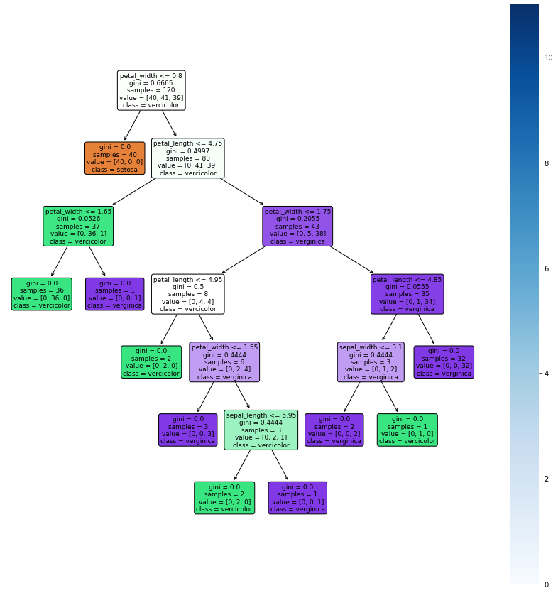
Decision tree

